Slide 4
Christ on the Cross
Matt. 26:47-67

Slide 5
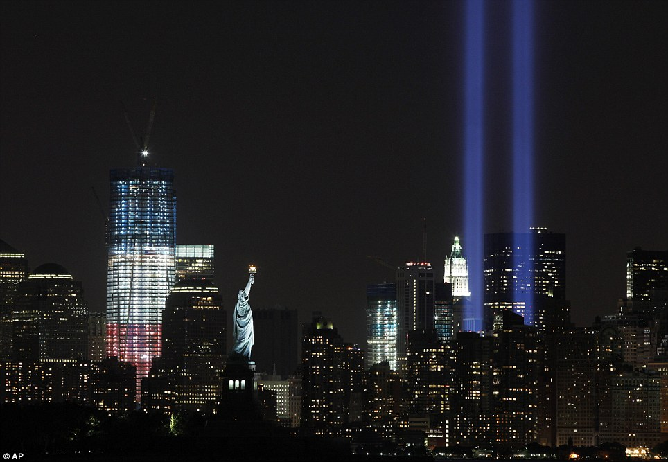

Slide 6
Friday, April, 29-30AD
Arrest and Trial
Crucifixion
“My God, My God, why have You forsaken Me?”
“I am thirsty”
“Father, Into Your hands I commit My spirit.”
“It is finished”

Slide 7
Friday, April, 29-30AD
Arrest and Trial
Crucifixion
Jesus knew He was born to die

Slide 9
Friday, April, 29-30AD
Arrest and Trial
Crucifixion
Jesus knew He was born to die
Who did Jesus die for?
Jesus’ promise to us

