Slide 10
The Sword of the Spirit
Ephesians 6:10-20

Slide 12
The Sword of the Spirit
Requires Training & Practice

Slide 13
The Sword of the Spirit
Requires Training & Practice
Parry Attacks

Slide 14
The Sword of the Spirit
Requires Training & Practice
Parry Attacks
Pierce And Cut

Slide 15
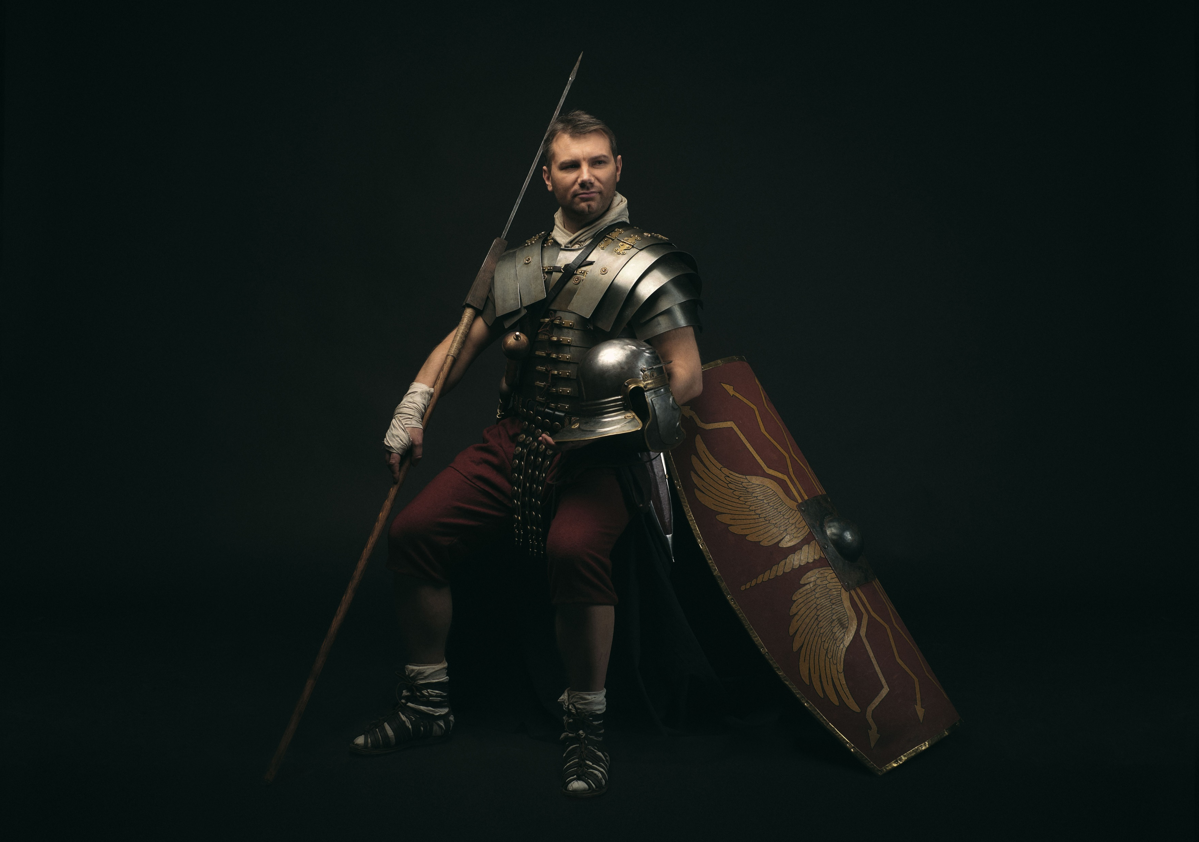
Belt of Truth
Breastplate of Righteousness
Helmet of Salvation
Sword of the Spirit
Shield of Faith
Gospel of Peace Shoes

