Slide 10
Being An
Matthew 5:1-16

Slide 12
Being An Influencer
Perfectly Imperfect

Slide 13
Being An Influencer
Perfectly Imperfect

Slide 14
Being An Influencer
Perfectly Imperfect

Slide 15
Being An Influencer
Perfectly Imperfect

Slide 16
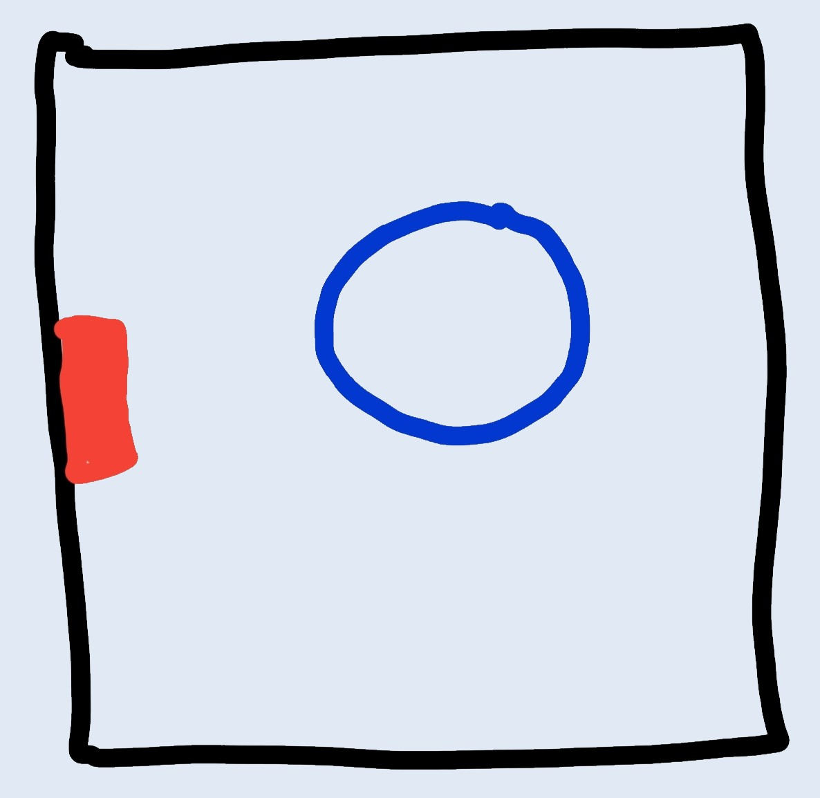
Being An Influencer
Perfectly Imperfect

Slide 17
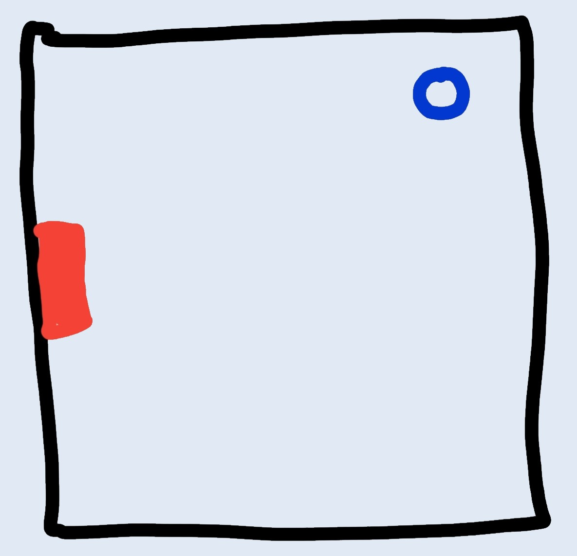
Being An Influencer
Perfectly Imperfect

Slide 18
Being An Influencer
Perfectly Imperfect

Slide 19
Being An Influencer
Perfectly Imperfect
Brand Ambassador

Slide 20
Being An Influencer
Perfectly Imperfect
Brand Ambassador
Influencing Daily

